Slide 1
How are national social partners addressing the issue of climate change and the impact on employment?
CASE STUDY: BELGIUM
Anne Defourny, VBO-FEB
Bert De Wel, ACV-CSC

Slide 2
Overview
Formal government consultation processes:
Central Business Council and National Labour Council on Green Jobs
Federal Council for Sustainable Development on the Climate Conference in Copenhagen
and on the CO₂ Price Signal
Ecocheques, a measure developed unilaterally among social partners
Some specific climate related initiatives of the social partners

Slide 3
Federal Council for Sustainable Development
FRDO-CFDD
trade unions & employers federations & consumers & NGO’s
Nov 2009
Joint statement:
on the climate conference
in Copenhagen
March 2010
Joint statement:
on CO₂ price signal
2008
2009
2010
…oct…dec… jan.. march ... may...july…sept…nov...jan…march…may…
Oct 2008
Request for joint statement on Green Jobs: Minister for Employment and Equal Opportunity
July 2009 :
1st joint statement
on Green jobs:
State of affairs
Topics to be discussed
March 2010:
2nd joint statement
on Green jobs:
- Consensual views over the topics
Central Business Council and National Labour Council
CRB-CCE/NAR-CNT
trade unions & employers federations

Slide 4
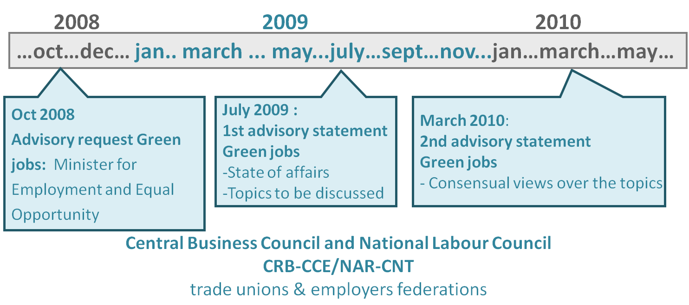
1a. Central Business Council and National Labour Council
Consensus opinion on green jobs:
Concept difficult to define (narrow and broad definition)
Lack of data for Belgium : SWOT analysis needed
Transition to a low carbon economy
Ambitious challenge and profound modification of the economy (like information society)
Risks must be neutralized
Opportunities for economic growth and jobs must be seized
Shared responsability
Public authorities : right framework conditions
Social partners: competitiveness of our companies and fair transition

Slide 5
Important role of the promotion of innovation, R&D, entrepreneuship, partnerships, standards, tools aiming to change behaviours
Education and training
New skills and new qualifications will be needed
Improvement of the match between demand and supply on the labour market
Anticipation of skills need to be developped

Slide 6
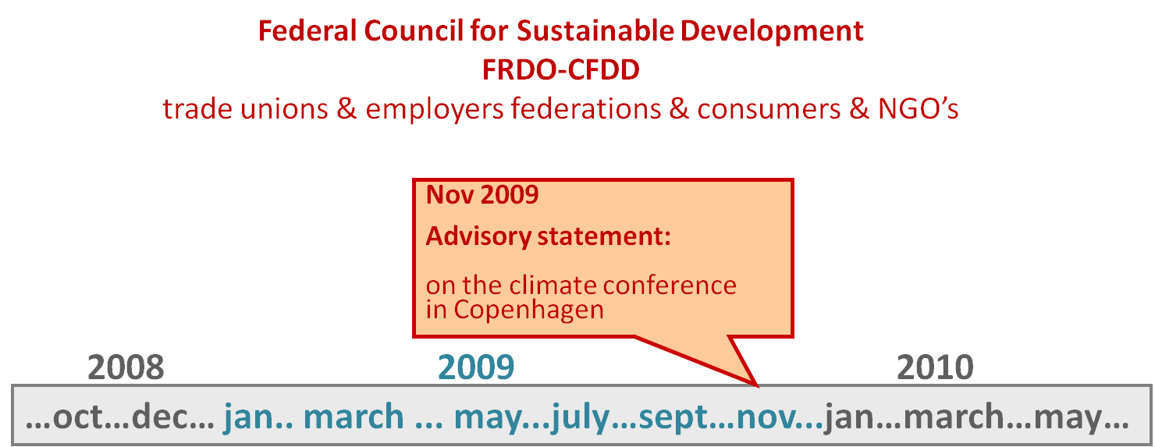
1b. Federal Council for Sustainable
development
Consensus opinion on the Copenhagen climate summit
Climate negotiations objective.
Competitiveness of our companies.
A fair transition enabling workers to have a decent job and income.
Principle that if the reduction of emissions within Belgium is less costly than the reduction through flexibility mechanisms, domestic measures should be taken.

Slide 7
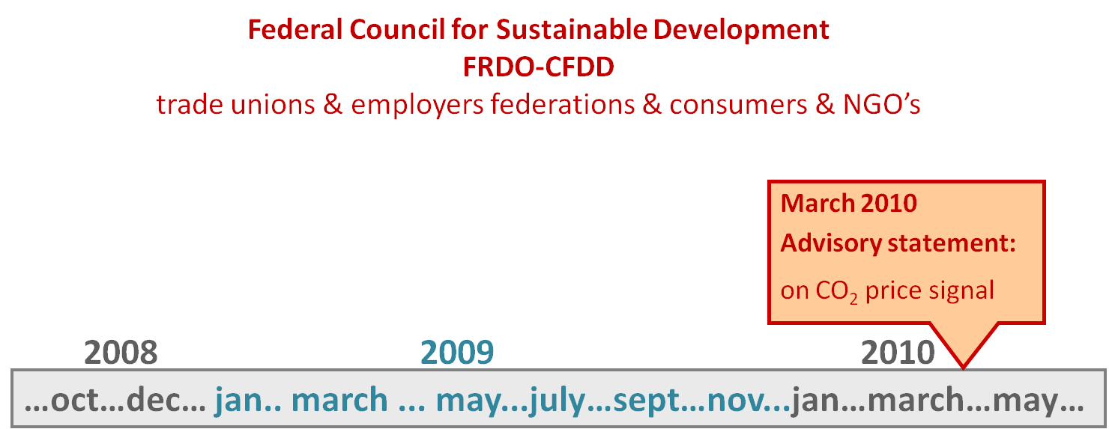
1c. Federal Council for
Sustainable Development:
Consensus opinion on the CO₂ Price Signal (CO₂ tax)
Need for an appropriate policy mix to achieve the objective pursued.
Strengthen the competitiveness of the Belgian economy which ensures employment and added value.
Encourage research and innovation.
Contribute to a fair transition by strengthening social cohesion.
Should fit in an environmental program, rather than within a budget program.

Slide 8
2. National Labour Council:
Ecocheques
A unilaterally measure of social partners.
Collective Industrial Agreements nr. 98, part of the Inter-professional agreement 2009-2010.
Tax-free bonus of 250 euro (2010) for employees to buy certain environmental goods and services (energy saving products, ecolabel products,…).
The direct employment impact is probably very limited.

Slide 9
3. Specific climate related initiatives of the social partners

Slide 10
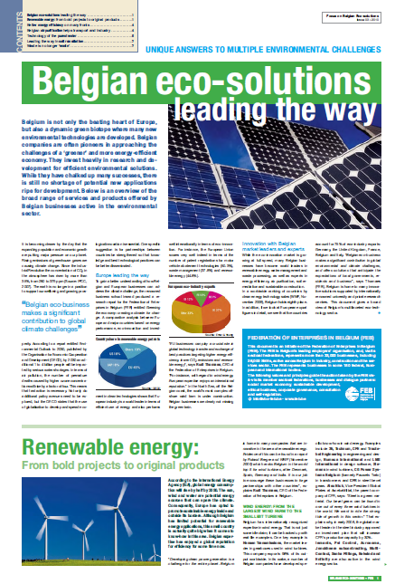
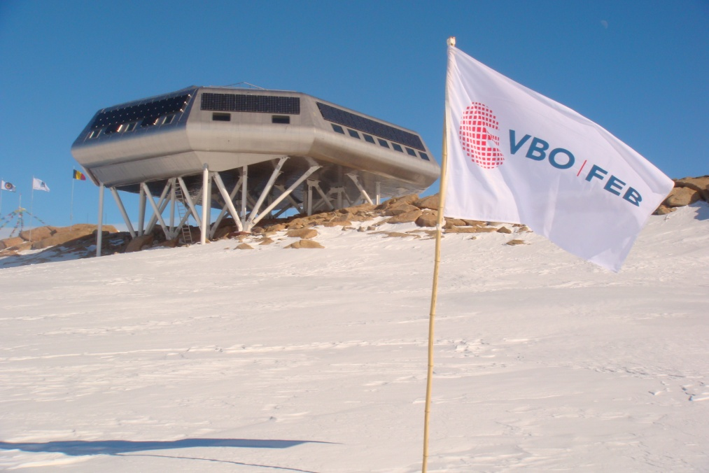
FEB: Promotion of Belgian eco-business abroad
Belgian eco-business makes a significant contribution to global environmental and climate challenges, and offers solutions that anticipate the expectations of local governments, residents and business

Slide 11
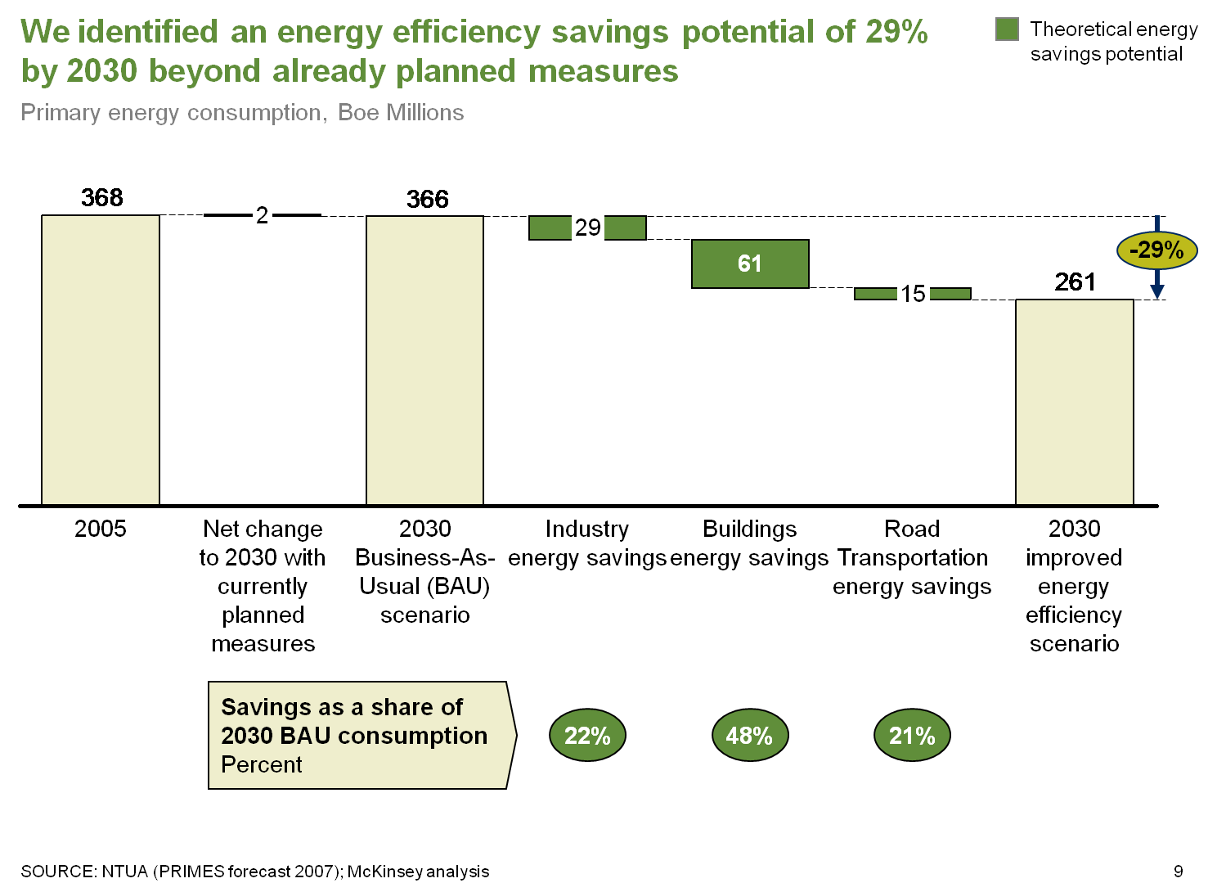
FEB: Forum on energy efficiency
McKinsey report: Energy efficiency saving potential of 29%
making Belgium one of the most efficient future economy in terms of energy
www.energyefficiency.be

Slide 12
Trade Unions
RISE and BRISE a joint network of trade unions on environment information for trade union representatives in the Walloon and Brussels region. => www.rise.be There is a similar project in Flanders.
Arbeid en Milieu joint organisation of trade unions with an environmental organisation => www.a-m.be
Climate Coalition: mobilisation network of environment and social organisations (Greenpeace, WWF, trade unions, etc.).

Slide 13
More information:
Anne Defourny VBO-FEB ad@vbo-feb.be Bert De Wel ACV-CSC BDeWel@acv-csc.be

